Slide 1


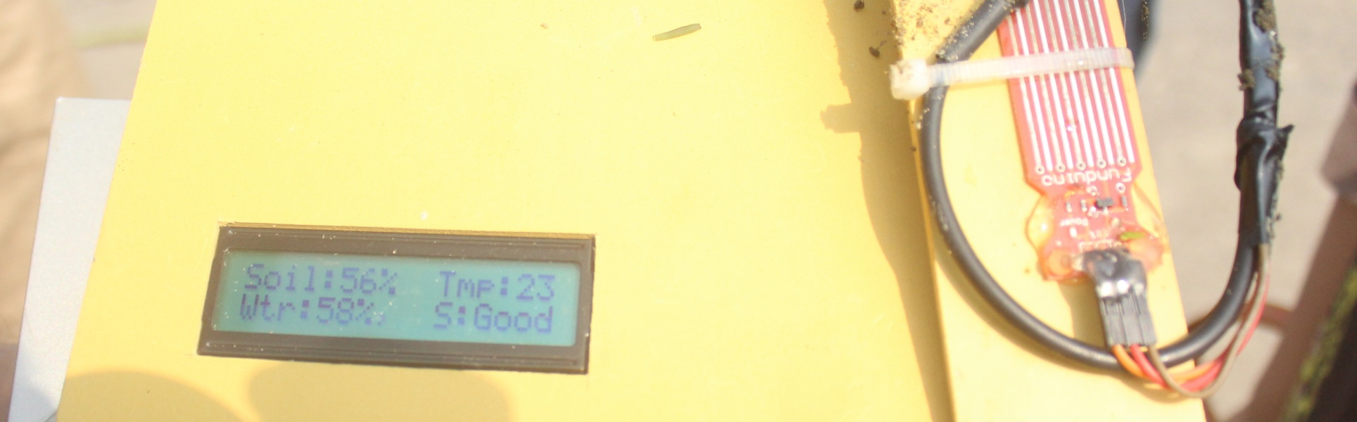
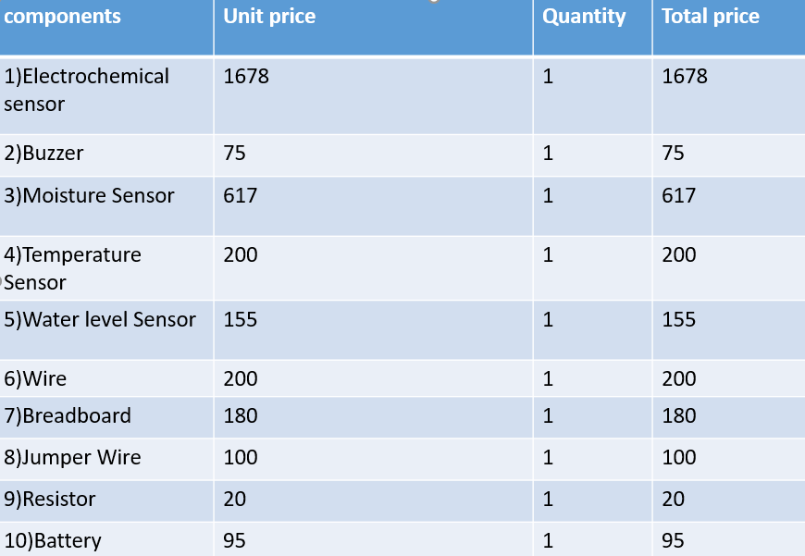


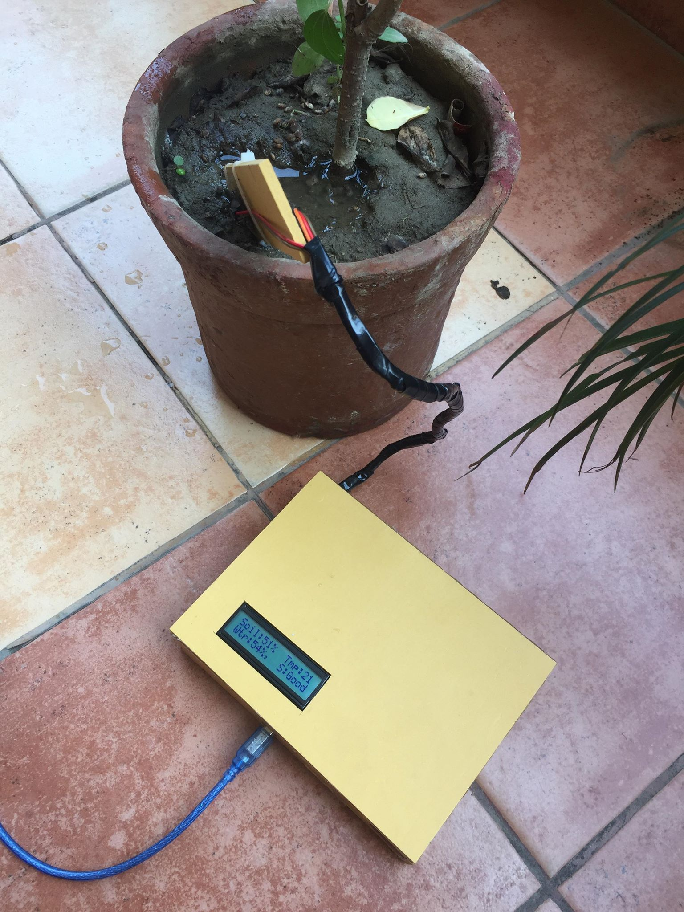
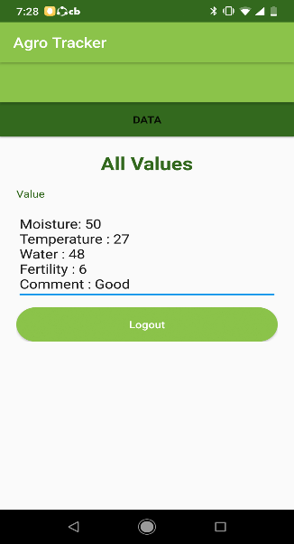
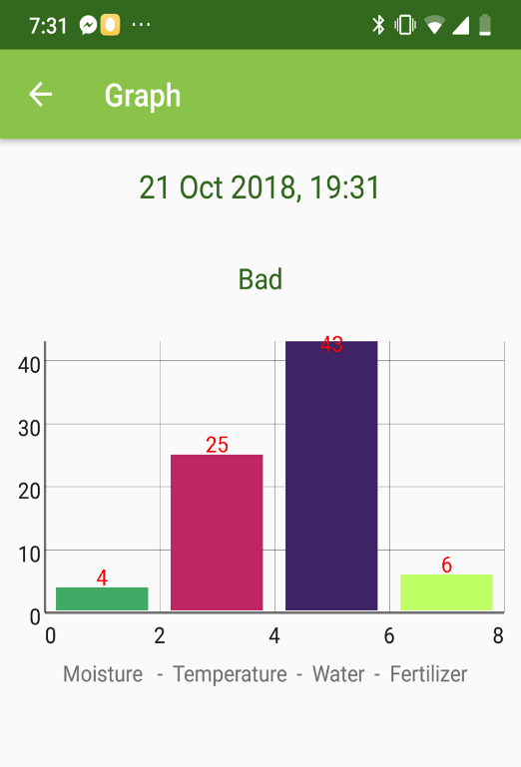
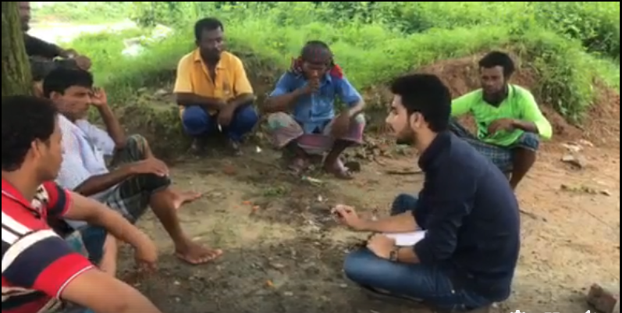
Agro Tracker
Annoor Ayesha Siddika, Shah Tuhin Ahmed, Sakibul Hassan, Mikdadul Islam
Advisor: Dr. Nova Ahmed
Department of Electrical and Computer Engineering | North South University
we present a device that will sense the fertilizer amount in their land so that farmers can get notified about the amount of fertilizer. Also we developed an app that will give the land owner notification about the result sensed by the device in their lands.
About
Operating Procedure
ABOUT
Cost
Cost
PRODUCT | UNIT PRICE (BDT) | QUANTITY | TOTAL PRICE (BDT)
Raspberry PI Model B | 3800tk | 1 | 3800tk
Brushless DC Servo Motor 1400KV (920g thrust) | 1300tk | 4 | 5200tk
Mystery Fire Dragon ESC 30Amp | 1200tk | 4 | 4800tk
Propeller (8”x4.5”) | 220tk | 4 | 800tk
LIPO Battery Charger | 3500tk | 1 | 3500tk
DJI f450 Quad copter frame | 1700tk | 1 | 1700tk
Triple Axis Accelerometer and Gyro Breakout - MPU-6050 | 3500tk | 1 | 3500tk
Wild Scorpion 3500mAh LiPo Battery | 2500tk | 1 | 2500tk
Wifi Dongle | 1000tk | 1 | 1000tk
Miscellaneous+ damage replacement cost |  |  | 7000tk
Total |  |  | 33800tk
Step 1
Turn on the bluetooth on your smartphone. Power on the device..
Wait for the module to detect the device.
Step 2
Launch the App. and connect it with the device
Step 3
Get the values from the device and display
Step 4
Check the previous testing values
Motivation
Farmers in Bangladesh have fewer knowledge about farming technology than other farmers across the world. So we present a device that will be attached to their land, which will sense the fertilizer amount in their land so that farmers can get notified about the amount of fertilizer present in their land. Also we developed an app that will give the land owner a notification about the result sensed by the device in their lands. The main initiative is to develop the farming technology in Bangladesh.
Setup
Results
Project Overview
The whole setup weighs approximately 0.5kg.
The device has a led display which displays moisture, temperature and water level
The display also shows the soil status
A 9v Adapter is used to power up the device
The device have the sensors connected to it through a wire
The sensors are adjacent to show the values correctly
The android app is connected with the device through module
Android app has been developed to send control signals to the device through a static IP.
The device is tested and verified to use in field level
The Arduino is based on the flexibility so that the user can handle it.
We have used 4 types of sensors which are temperature, moisture, water level and pH.
Using 9v battery Arduino gets the power. we have added GSM Module for sending SMS to the farmers and land owners with an alert.
Android App has been developed to allow the user to get to know the readings of the soil properties with status, graphs and log history.
User can see the moisture value, temperature value and wallet level on both app and device
The led display shows the values as well as the soil status
With the app user can see the comparison graph of the values and also can see the previous output values
When the soil status go from Good to Bad there is a SMS generated and sent to land owner and farmer
It is easy to use both in software and hardware.
Conclusion
We have implemented a digital agricultural system which can be used in testing the fertility of soil.
We have achieved our goal of implementing an agricultural system which is cost effective and user friendly.
In future we are planning to make more advance changes so that the problems of farmers and owners can decrease a bit more.
Our Field Test
Interview Of Farmers
Indoor Testing
.
Outdoor Testing
References
Acknowledgement
[Zhan Huan, Hui Wang, Chen Li, and Caiyan Wan. 2017. The soil moisture sensor based on soil dielectric property. Personal Ubiquitous Comput. 21, 1 (February 2017), 67-74. DOI: https://doi.org/10.1007/s00779-016-0975-z]
[Tatsuya Yamazaki and Kazuya Miyakawa. 2017. Soil Moisture Sensing Experiments for Water Management in Pear Fields. In Proceedings of the 6th International Conference on Informatics, Environment, Energy and Applications (IEEA '17). ACM, New York, NY, USA, 56-59. DOI: https://doi.org/10.1145/3070617.3070633]
Our project report titled “Agro Tracker”, would not have been successful without the collective collaboration of our friends, respected faculty members and of course, last but not the least, our families and friends. I would like to thank my supervisor Dr. Nova Ahmed who is a prestigious faculty member of Electrical Engineering and Computer Science department, for overseeing our project with a keen eye and giving us valuable advice and suggestions

